Slide 1
Requirements Analysis
Prepared By:
Group: CHAMP

Slide 2
What is Requirement Analysis
Requirements analysis in systems engineering and software engineering, encompasses those tasks that go into determining the needs or conditions to meet for a new or altered product or project, taking account of the possibly conflicting requirements of the various stakeholders, analyzing, documenting, validating and managing software or system requirements
Requirements analysis, also called requirements engineering, is the process of determining user expectations for a new or modified product.

Slide 3
Requirement Analysis
Software engineering task bridging the gap between system requirements engineering and software design.
Provides software designer with a model of:
system information
function
behavior
Model can be translated to data, architectural, and component-level designs.
Expect to do a little bit of design during analysis and a little bit of analysis during design.

Slide 4
Why do we need Requirement Analysis
If requirement analysis is not completed properly or in a wrong manner, there might be inconsistencies in the final product.
During requirements gathering, the client is not able to provide more details or indicate what exactly he needs.
Irregular communication between the parties involved in the process.
Timelines might not be achievable if no requirements analysis is done.
If the requirements change on some stage later or at the end, the project team will be pushed too much behind the schedule if no prior requirement analysis is carried out.
Improper documentation.

Slide 5
Management Questions
How much effort put towards analysis?
Who does the analysis?
Why is it so difficult?
Bottom line - who pays for it?

Slide 6
Analysis Principles
Information domain of problem must be presented & understood.
Models depicting system information, functions, and behavior should be developed.
Models and problems must be partitioned in a manner that uncovers detail in layers.
Analysis proceeds from essential information toward implementation detail
Must be traceable.

Slide 7
Information Domain
Encompasses all data objects that contain numbers, text, images, audio, or video.
Information content or data model
shows the relationships among the data and control objects that make up the system
Information flow
represents manner in which data and control objects change as each moves through system
Information structure
representations of the internal organizations of various data and control items

Slide 8
Modeling
Data model
shows relationships among system objects
Functional model
description of the functions that enable the transformations of system objects
Behavioral model
manner in which software responds to events from the outside world

Slide 9
Partitioning
Process that results in the elaboration of data, function, or behavior.
Horizontal partitioning
breadth-first decomposition of the system function, behavior, or information, one level at a time.
Vertical partitioning
depth-first elaboration of the system function, behavior, or information, one subsystem at a time.

Slide 10
Specification Principles - 1
Separate functionality from implementation.
A process-oriented specification language is needed.
Specification must encompass the system containing the software component.
Specification must encompass the environment.
System specification = cognitive model.

Slide 11
Specification Principles - 2
Specification must be operational (talk about how it works).
Must be tolerant of incompleteness and easy to add to.
Specification must be localized and loosely coupled (pieces of things are independent of each other).

Slide 12
Specification Representation
Representation format and content should be relevant to the problem.
Information contained within the specification should be nested.
Diagrams and other notational forms should be restricted in number and consistent in use.
Representations should be revisable.

Slide 13
Specification Review
Conducted by customer and software developer.
Once approved, the specification becomes a contract for software development.
The specification is difficult to test in a meaningful way.
Assessing the impact of specification changes is hard to do.

Slide 14
Requirements Review
Goals & objectives review.
Compare requirements to goals & objectives.
Consider system operating environment.
Assess and document all risks in system developmental operation.
Discuss testing procedure.

Slide 15
Requirements
Types
15

Slide 16
Functional and Non-functional Requirements
16
Functional Requirements
These are statements of services the system should provide, how the system should react to particular inputs and how the system should behave in particular situations.
Non Functional Requirements
These are constraints on the services or functions offered by the system. They include timing constraints, constraints on the development process, standard and so on.
Domain requirements
Requirements that come from the application domain of the system and that reflect characteristics of that domain.

Slide 17
Non-Functional Requirements
17
Non-functional requirements arise through user needs, because of budget constraints, because of organizational policies, because of the need of interoperability with other software and hardware systems, or because of external factors such as safety regulations, privacy legislation, etc.

Slide 18
Non Functional Requirements
Product Requirements
Efficiency Requirements
Performance Requirements
Space Requirements
Reliability Requirements
Portability Requirements
Usability Requirements
Organizational Requirements
Delivery Requirements
Implementation Requirements
Standard Requirements
External Requirements
Interoperability Requirements
Ethical Requirements
Legislative Requirements
Privacy Requirements
Safety Requirements
18

Slide 19
Non-functional requirement types

Slide 20
Domain requirements
Derived from the application domain and describe system characteristics and features that reflect the domain.
Domain requirements be new functional requirements, constraints on existing requirements or define specific computations.
If domain requirements are not satisfied, the system may be unworkable.

Slide 21
Inverse Requirements
21
They explain what the system shall not do. Many people find it convenient to describe their needs in this manner
These requirements indicate the indecisive nature of customers about certain aspects of a new software product
Example: The system shall not use purple color in the user interface, whenever it is asking for inputs from the end-user

Slide 22
Software Requirements: 10 Traps to Avoid
22
Confusion about what a requirement is
Inadequate customer involvement
Vague and ambiguous requirements
Un-prioritized requirements
Building functionality no one uses
Analysis paralysis
Scope creep
Inadequate requirements change process
Insufficient change impact analysis
Inadequate requirements version control

Slide 23
System Contract Requirements
23
Software requirements may be:
Part of the bid of contract
The contract itself
Part of the technical document, which describes a product

Slide 24
Requirements
Engineering
Process
24

Slide 25
Two Main Tasks of Requirements Engineering
There are two main tasks which needs to be performed in the requirements engineering process.
Problem analysis
Analysis of a software problem
Product description
Complete specification of the desired external behavior of the software system to be built. Also known as functional description, functional requirements, or specifications
25

Slide 26
Requirements Engineering Process

Slide 27
Requirements Engineering Activities
Requirements
Elicitation
Requirements
Analysis and
Negotiation
Requirements
Specification
Requirements
Validation
User Needs,
Domain Information,
Existing System
Information, Regulations,
Standards, Etc.
Agreed
Requirements
Requirements
Document
27

Slide 28
Requirements Engineering Process
28
The requirements engineering process begins with inception, moves on to elicitation, elaboration & negotiation, problem specification, and ends with review or validation of the specification.
The intent of requirements engineering is to produce a written understanding of the customer's problem.
Several different work products might be used to communicate this understanding (user scenarios, function and feature lists, analysis models, and specifications).

Slide 29
Requirements Engineering Tasks
Inception
software engineers use context-free questions to establish a basic understanding of the problem, the people who want a solution, the nature of the solution, and the effectiveness of the collaboration between customers and developers
Requirements elicitation
find out from customers what the product objectives are, what is to be done, how the product fits into business needs, and how the product is used on a day to day basis
Requirements analysis and negotiation
requirements are categorized and organized into subsets, relations among requirements identified, requirements reviewed for correctness, requirements prioritized based on customer needs
29

Slide 30
Requirements Engineering Tasks (cont’d)
30
Requirements specification
work product produced describing the function, performance, and development constraints for a computer-based system
System modeling
system representation that shows relationships among the system components
Requirements validation
examines the specification to ensure requirement quality and that work products conform to agreed upon standards

Slide 31
Spiral Model of Requirements Engineering Process
Informal statement of
requirements
Requirement
elicitation
Requirement analysis
and negotiation
Requirements
document and
validation report
Agreed
requirements
START
Requirement
validation
Requirement
documentation
Draft requirements
document
31

Slide 32
Tools use in Requirement Analysis

Slide 33
Tools use in Requirement Analysis
Story board
Context diagram
Functional Decomposition
Use Case Diagram
Sequence Diagram

Slide 34
Storyboard
A Storyboard is a logical and conceptual description of system functionality for a specific scenario, including the interaction required between the system users and the system.
A Storyboard "tells a specific story".
A storyboard serves multiple purposes
– helps understand how requirements impact implementation and test
– describes how a system or part of a system is intended to work “before the fact”
– documents system functionality
Communicate and verify functionality with relevant stakeholders
– often not technical or programming savvy

Slide 35
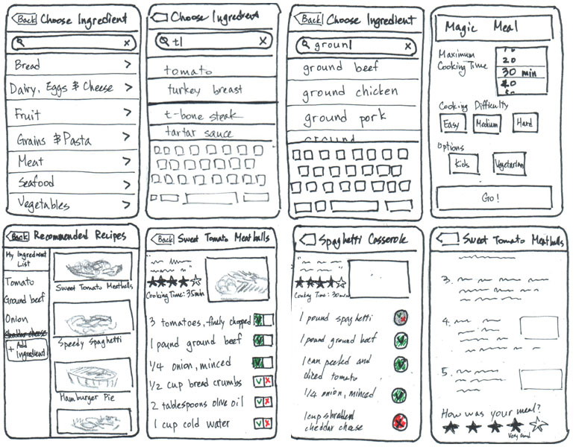
35

Slide 36
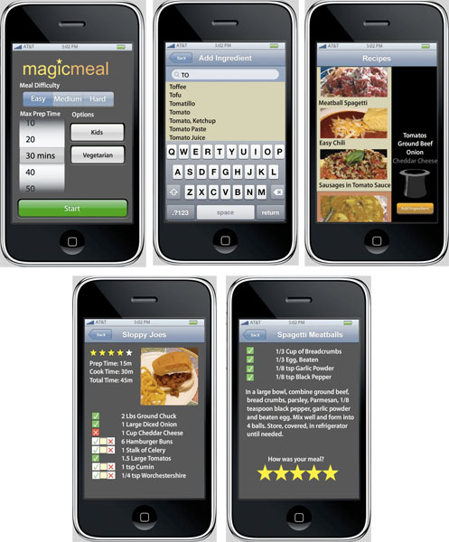
36

Slide 37
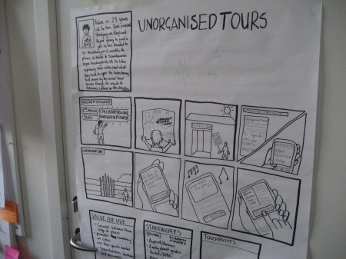
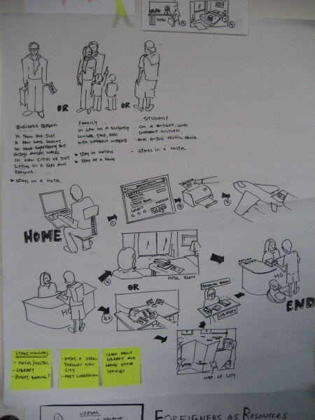
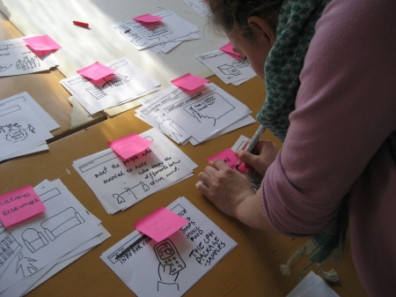
37

Slide 38
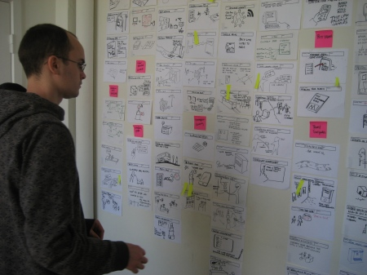
38

Slide 39
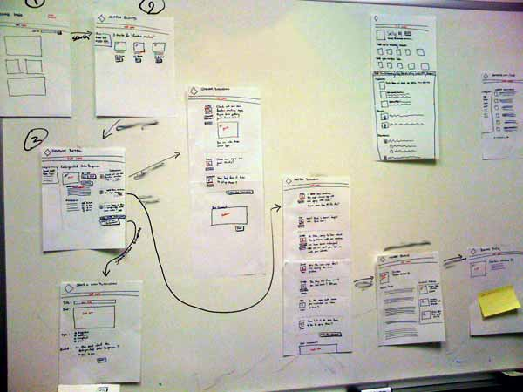
39

Slide 40
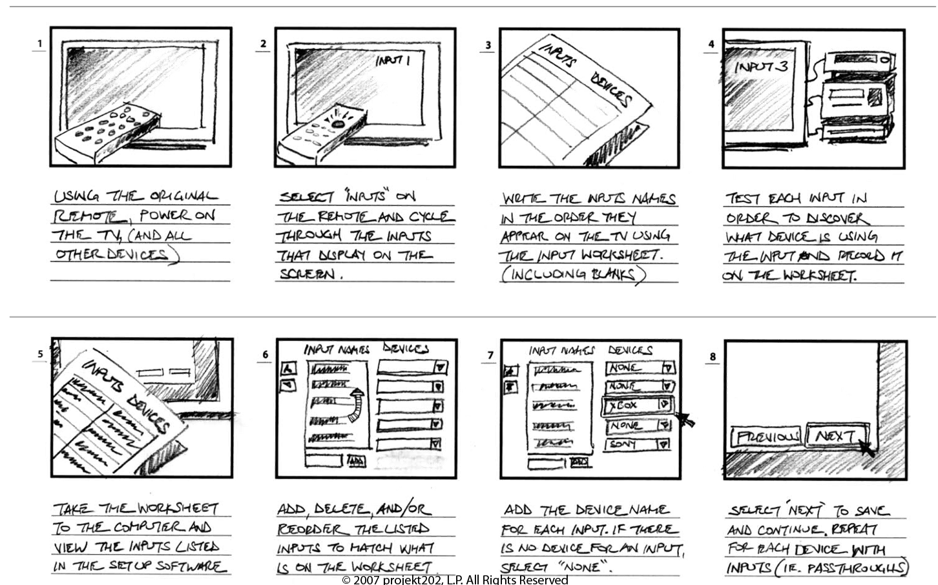
40

Slide 41
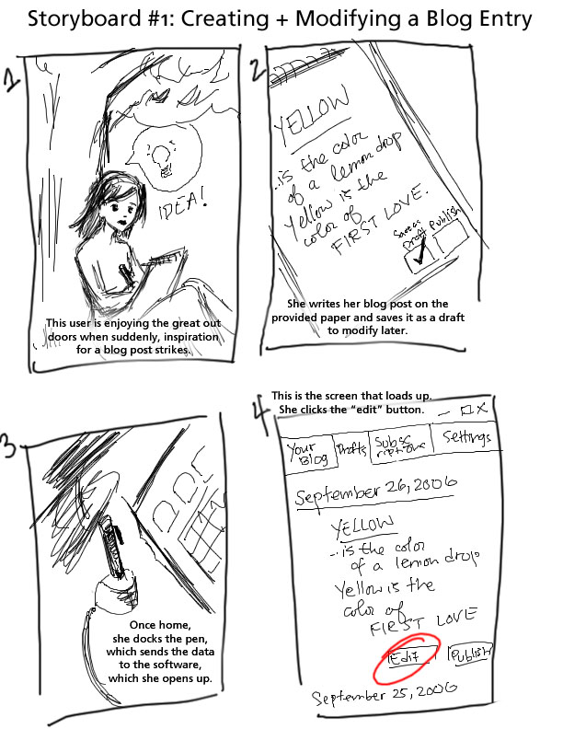
41

Slide 42
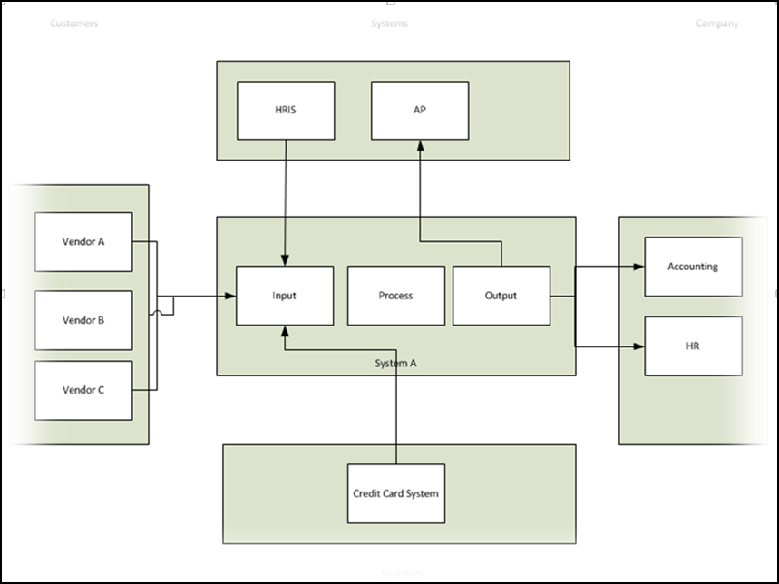
Context Diagram
A system context diagram defines the system’s boundary, its surrounding environment and all the interacting entities. The system is plotted in the middle of the diagram and identifies customers, external or internal systems, the organization’s end users and any vendors or suppliers providing third-party services.

Slide 43
Context Diagram..2
By building a visual model of the software solution, you have a better understanding of the major interactions and players in your system. It also helps to define the context where the system sits so the end user can agree to what is in scope and what is out of scope in the project.

Slide 44
Functional Decomposition
A functional decomposition diagram provides a top-down view of the business process and/or the system’s major functions. When someone think about what they system should do, he/she will use the functional decomposition diagram to break it down into major chunks. This view also helps validate all the functions the system should provide. It’s similar to an organization chart and your end user should be able to easily relate to this model.

Slide 45
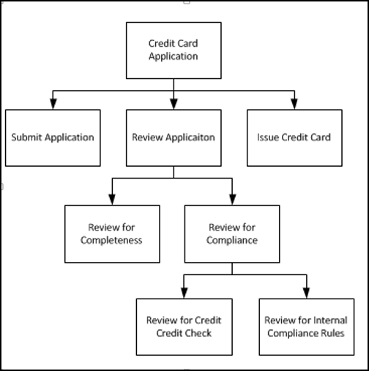
Functional Decomposition diagram

Slide 46
Use case diagram
The use case diagram helps depict the interaction between the system and its users. Each user role is called an “actor” and different processes or functions are represented in the diagram. Each of these interactions can be further broken down into steps including the “happy path” and alternative paths.

Slide 47
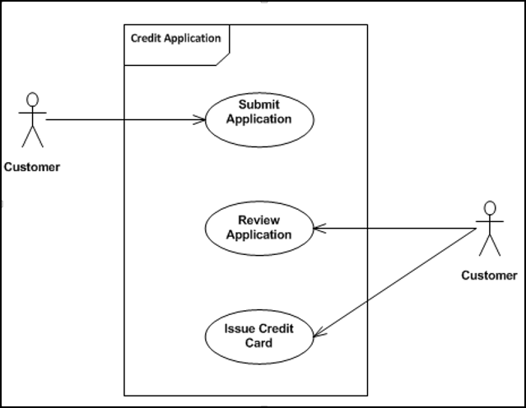
Use case Diagram

Slide 48
Use Case Diagram
Here’s how it breaks down:
Use case: Submit Application
Actor: Customer
Description: Describes the Credit Card application submission process
Successful completion:
User enters application information including social security number.
System validates input for data entry errors.
System submits application.
Alternative: System rejects submission, citing form entry errors for social security number.
Pre-condition: User has been routed to credit application from email campaign or website.
Post-condition: User receive success message.
Assumptions: None

Slide 49
Sequence Diagram
A sequence diagram shows the interactions between objects over time. It provides a top-to-bottom view with messages being sent back and forth between the different objects. The objects can be actors, systems or sub-packages within a system.
In the example below, the sequence diagram could be used to identify the different types of email notifications that need to be sent to the customer and the credit card company’s reviewer.

Slide 50
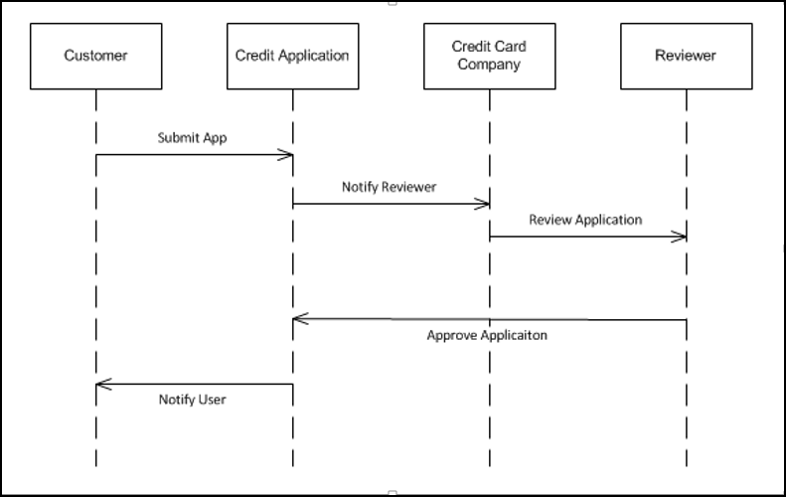
Sequence Diagram

